Slide 1


Manuel, Alessia, Joel, Maïlys, Flory

Slide 2
Project Overview
The dataset description
The dataset originates from the Global Shark Attack File and contains records of shark attacks, including details like date, location, activity, and outcomes.
Research questions:
What are the 5 most frequent countries with shark attacks?
What is the sport activity with highest number of shark attacks?
Are the shark attacks mostly provoked?
Are shark attacks more frequent in males or females?

Slide 3
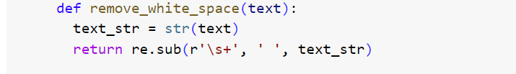
Project Overview
1- Overview Dataframe structure, “nunique” to spot inconsistencies
2- General column cleaning: merging columns, dropping empty columns as ‘href’, 'PDF' and 'Source’, removing empty spaces.
3- Specific data cleaning in some columns to test our hypothesis:
Countries: uppercase conversion, removing white spaces, removed unique values less frequent than 10, retained 5 most frequent values
Activity: removed unique values less frequent than 10
Type: removed unique values less frequent than 10
Gender: removed duplicates, errors, less frequent than 10 distributed NaN
Date : trying to format it as date instead of object

Slide 4
Major Obstacle
Because of missing/NaN and inconsistent values, we had to decide on analysis strategy
Options :
We remove all rows having missing/NaN values -> only 24% of rows remaining (6969 to 1651)
We clean every single row -> too many inconsistencies
We decide some columns mustn't have missing/NaN/inconsistent values and focus analysis on those
Long document, hard to remember everything we did, naming not always clear, need more functions
→ our strategy

Slide 5
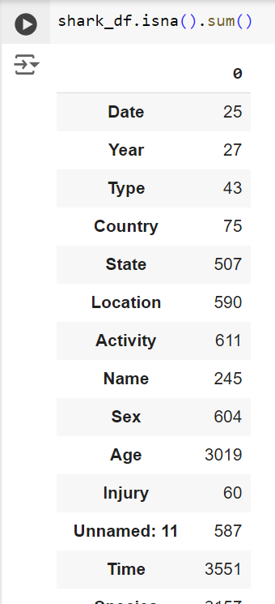
Analysis results
We dropped ‘Age’ because of more than 50% of missing values.
We dropped ‘Injury’ because the aim is to avoid all types of injuries.
We dropped ‘Name’ because wasn’t useful for the analysis.

Slide 6
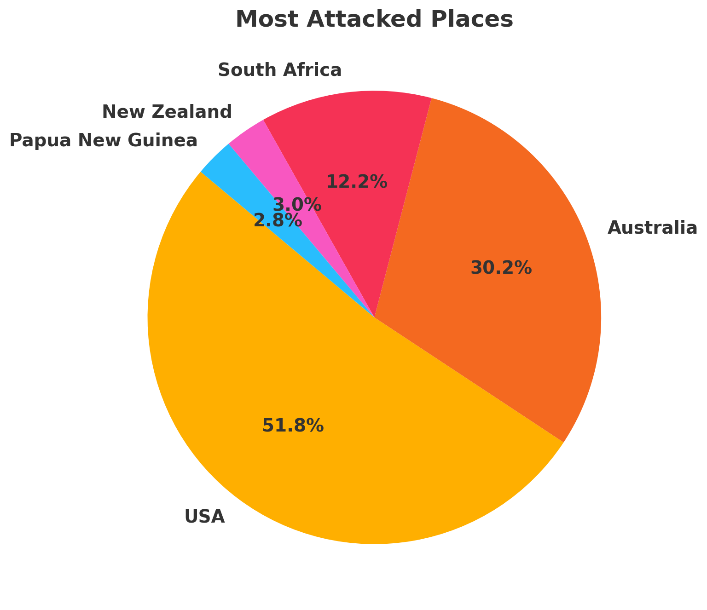
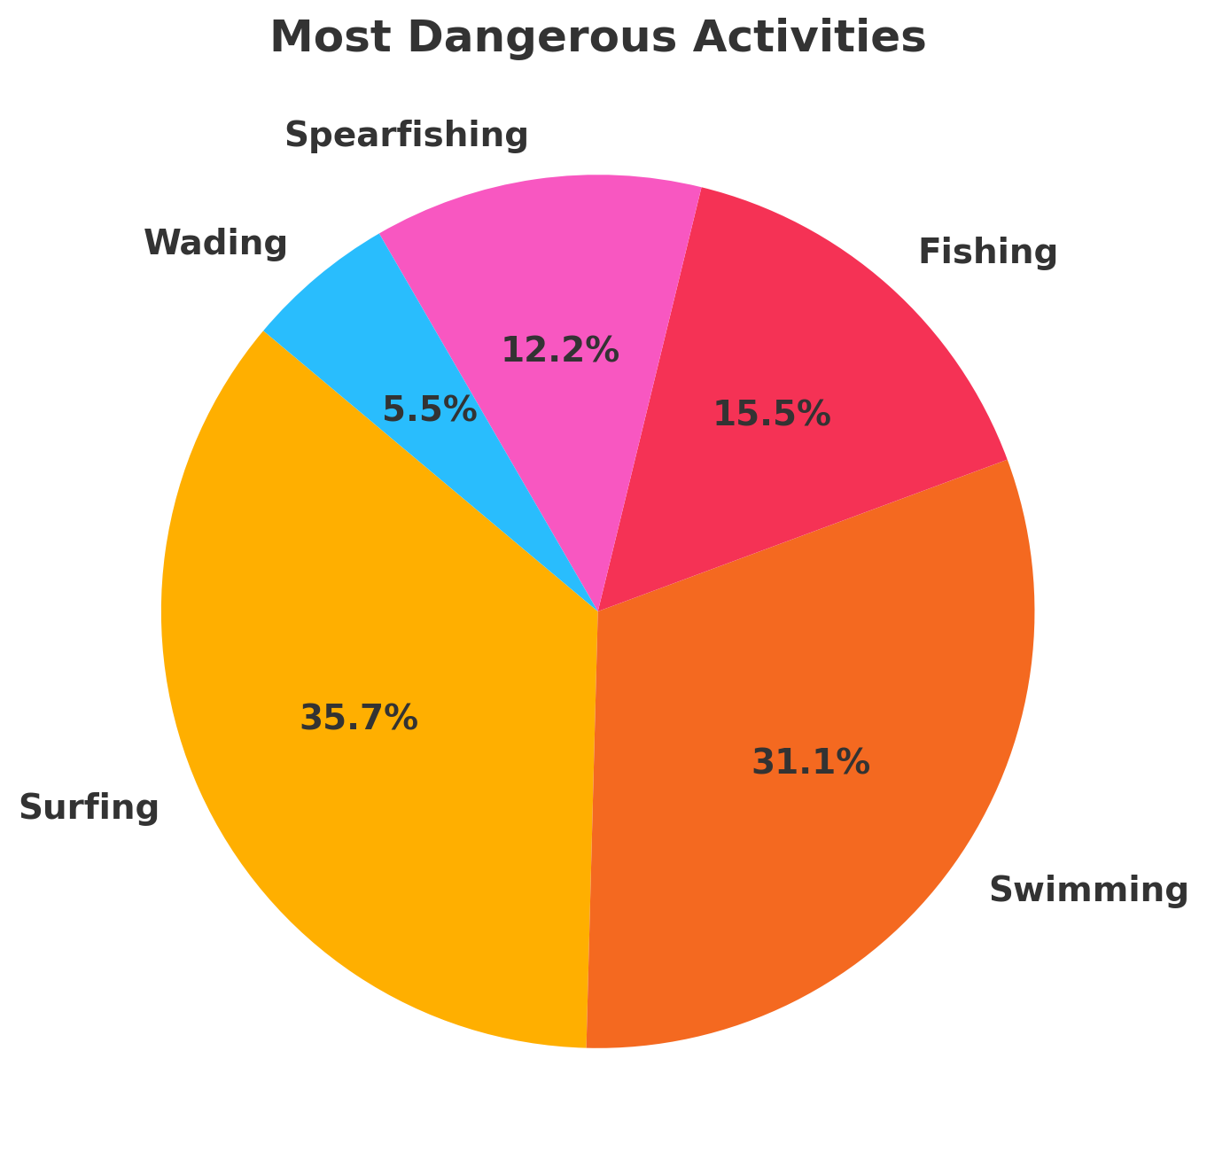
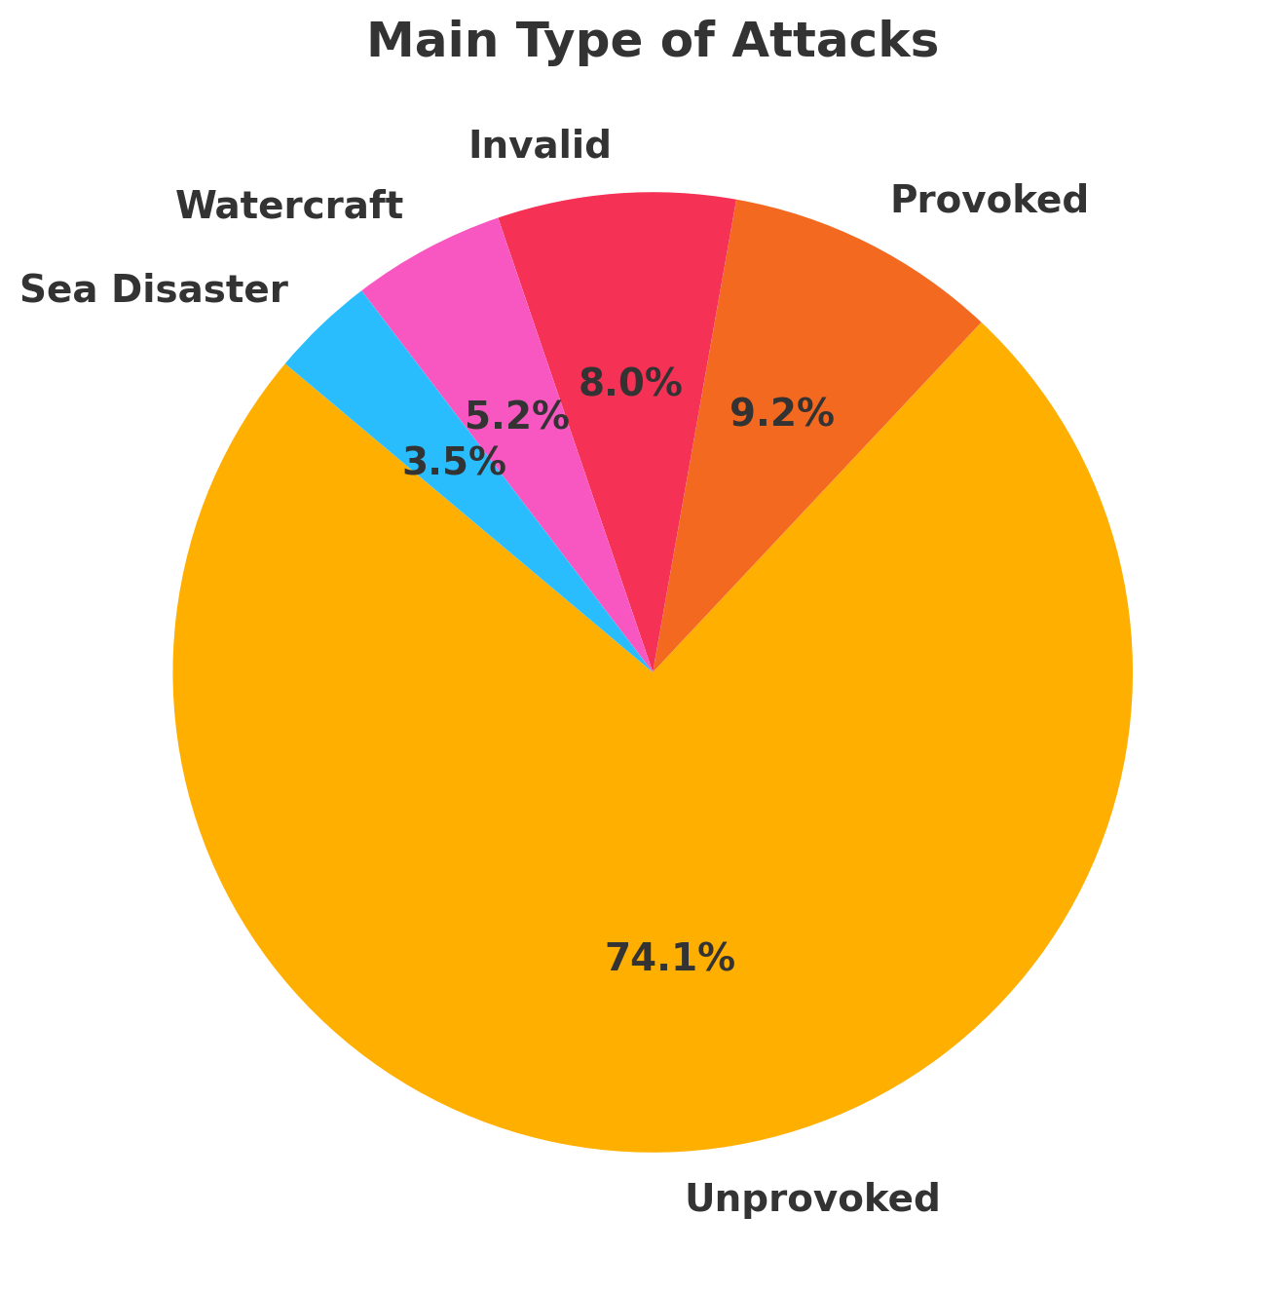
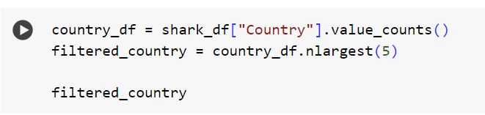
Analysis results
5 Most attacked places
5 Most dangerous activities
5 Main type of attacks

Slide 7
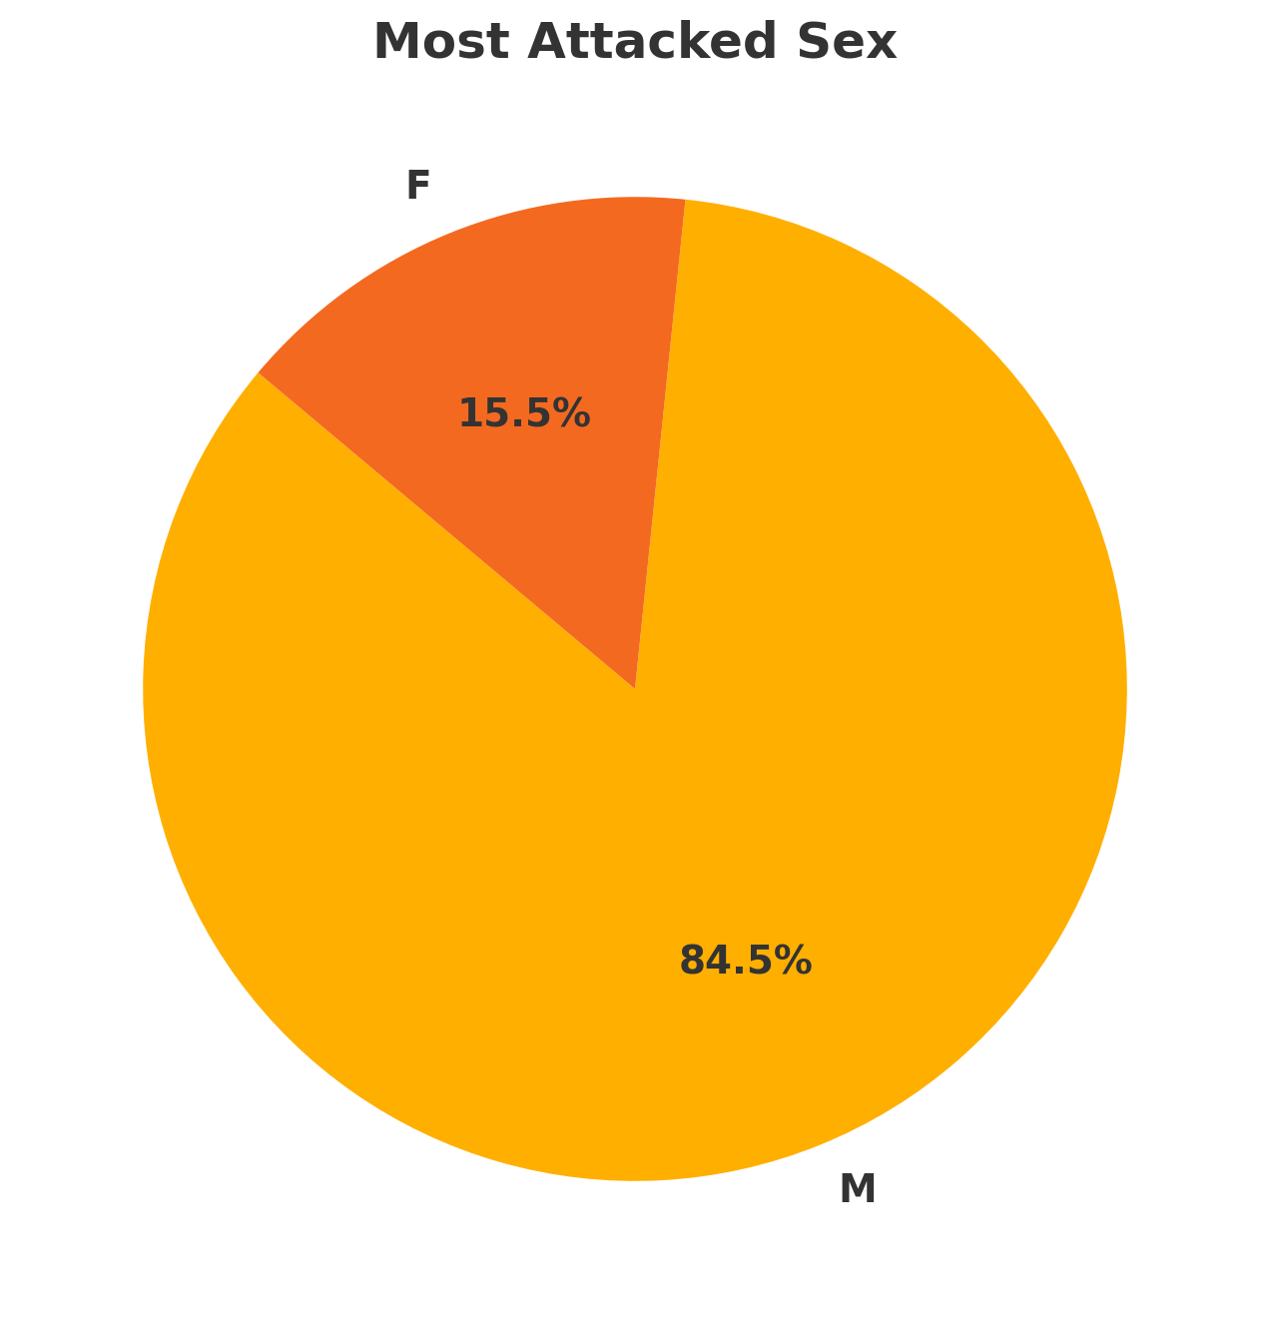
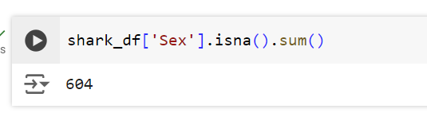
Analysis results
Most attacked sex
/!\ Many empty rows in Sex column

Slide 8
Conclusion
USA, South Africa & Australia are dangerous places to be surfing and swimming in. Men seem to be more likely to takes those risks.
Authorities must alert the public of the risks they take while doing water activities in those areas.
We advise to conduct a qualitative study on those areas and determine how those accidents could have been avoided.

Slide 9
Project Overview cont’d
The structure and process of data cleaning and analysis.
1- Overview Dataframe structure and data understanding
2- General column cleaning: merging columns, dropping empty columns
3- data cleaning in specific columns that we need to test our hypothesis:
Countries: uppercase conversion, removing white spaces, removed unique values less frequent than 10, retained 5 most frequent values
Activity: removed unique values less frequent than 10
Type: removed unique values less frequent than 10
Gender: removed unique values less frequent than 10
Date
TO DO: remove/replace NaN from columns
Format Date + Reset index
Technique and method employed
1- Analysed Dataframe structure:
Df.shape
Df.describe
Df.nunique
Df.columns
Df.unique for each columns (used for loop)
2- columns issues:
Identified 2 duplicated columns names and merged them:
df["col1"] = df["col1"].combine_first(df["col2"])
df = df.drop("col2", axis=1)
Removed 3 columns with empty values and unnamed:
df.drop(columns = [“col”])
3- issues with values inside specific columns:
Duplicated countries in upper and lower case → we converted all to uppercase
shark_df["Country"] = shark_df["Country"].str.upper()

Slide 10
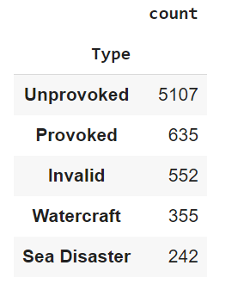
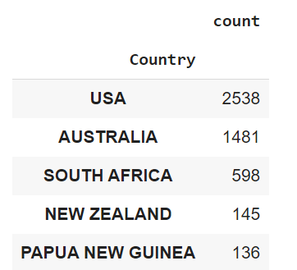
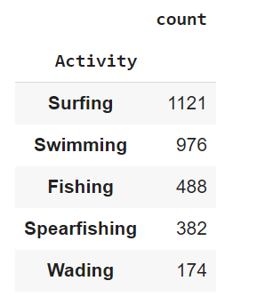
Analysis results
5 Most attacked places
5 Most dangerous activities
5 Main type of attacks

Slide 11
Data Wrangling and Cleaning
Significant data cleaning challenges
Significant amounts of missing data across various columns.
Presence of irrelevant columns such as ‘href’, 'PDF' and 'Source' that do not contribute to analysis.
Handling incorrecDid the number of shark attacks increase over the years?tly formatted data, especially in date and time columns.
How it was resolved
Columns unrelated to the analysis were dropped.
Employed pandas' functionalities like dropna() for rows with excessive missing values and drop() for irrelevant columns.

Slide 12
Exploratory Data Analysis
Exploratory data analysis methods
Insights and interesting patterns found

Slide 13
Conclusion and Insights

